Slide 1

Diabete. Fisiopatologia e recenti frontiere farmacologiche
Angelo avogaro
Universita’ di padova

Slide 2
CONFLITTI DI INTERESSE DI ANGELO AVOGARO
In qualità di RELATORE, ai sensi dell’art.76 sul Conflitto di Interessi dell’Accordo Stato-Regioni del 2 febbraio 2017, dichiaro che negli ultimi due anni ho avuto i seguenti rapporti di finanziamento con soggetti portatori di interessi commerciali in campo sanitario:
Novo, Lilly, Sanofi, Astrazeneca, Boehringher, Amgen, Dayki Sankio, MSD, Amarin, Bruno Farmaceutici

Slide 3
Definizione ed Epidemiologia del Diabete di Tipo 2
Fisiopatologia tradizionale: Resistenza insulinica progressiva associata a disfunzione delle cellule beta pancreatiche
Prevalenza globale: Oltre 537 milioni di adulti affetti nel 2024, con incidenza in continua crescita
Fattori di rischio T2D: Obesita’, sedentarieta’, predisposizione genetica, fattori socio-economici e demografici

Slide 4



In Patients with T2DM, the complexity of the disease leads to hyperglycemia
Vascular insulin resistance
Skeletal muscle
Pancreas
GI tract
Impaired
incretin effect
Beta cells
Alpha cells
Fat cells
Altered fat metabolism
Increased glucagon secretion
Hepatic sensitivity to glucagon
Brain
Liver
Insulin resistance
Inadequate insulin secretion
Increased hepatic glucose production
Inflammation†
Increased blood glucose
Kidney
Enhanced glucose reabsorption
†Mediated by IκB─NF-κB, TLR4, MAPK, AMPK, TNF, ROS, macrophages. GI, gastrointestinal. 1. Cernea S, Raz I. Diabetes Care. 2011;34(Suppl 2):S264–S271.

Slide 5
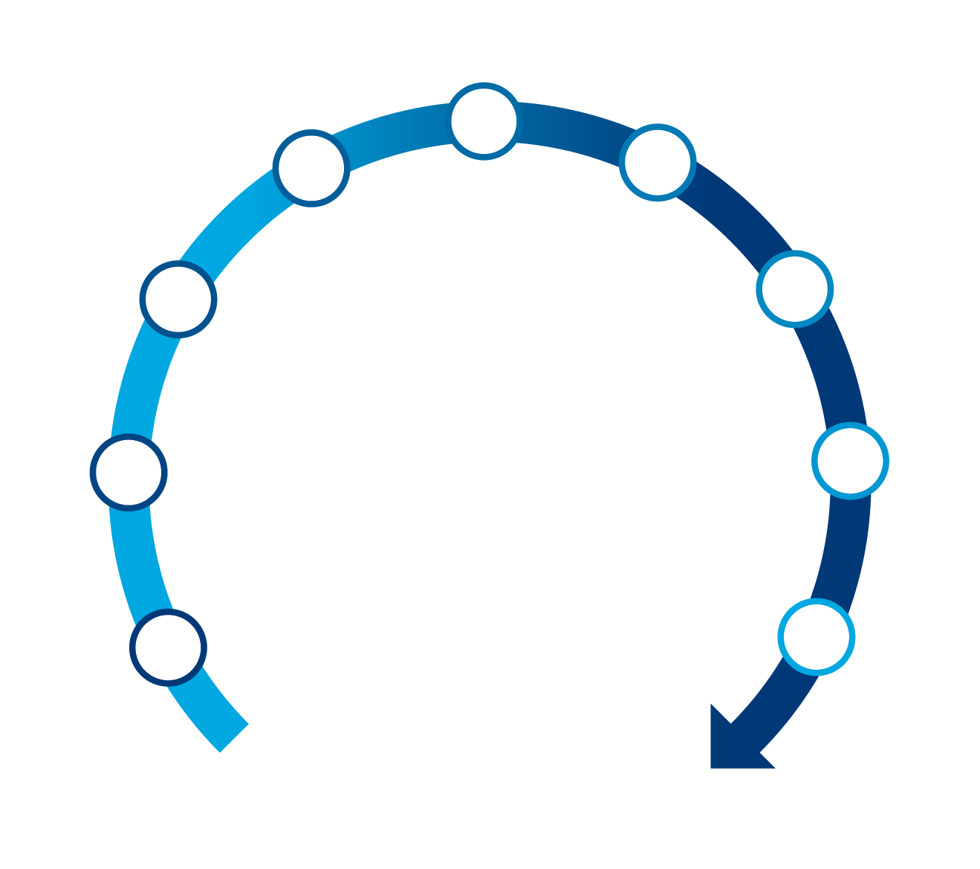
La traiettoria cardio-metabolica
Atherothrombosis
Low-grade Inflammation
Renal failure
Platelets dysfunction
Symptomatic CHD
Microvascular
Dysfunction
Heart failure
Endothelial dysfunction
End-stage renal disease
Diabetes
Obesity
Hypertension
Dyslipidemia
Death

Slide 6
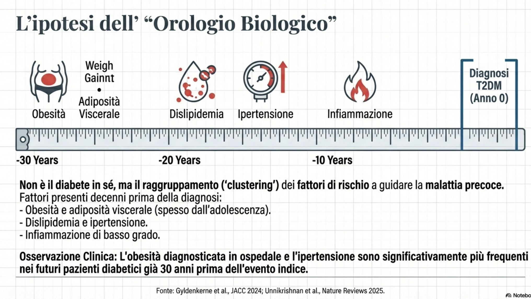

Slide 7
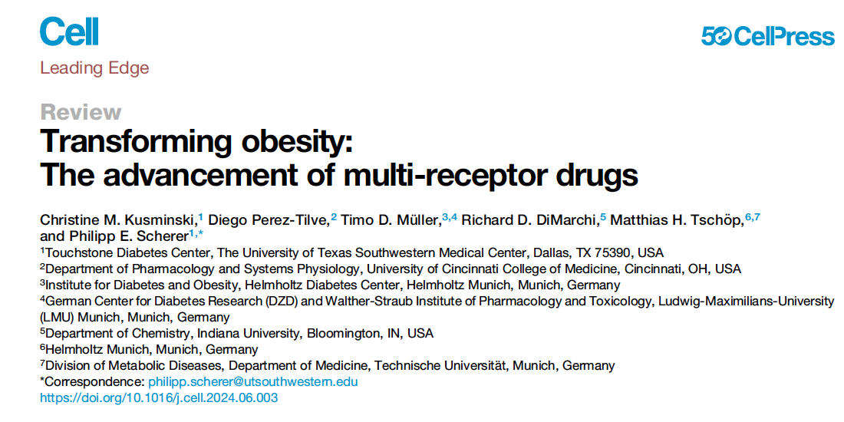
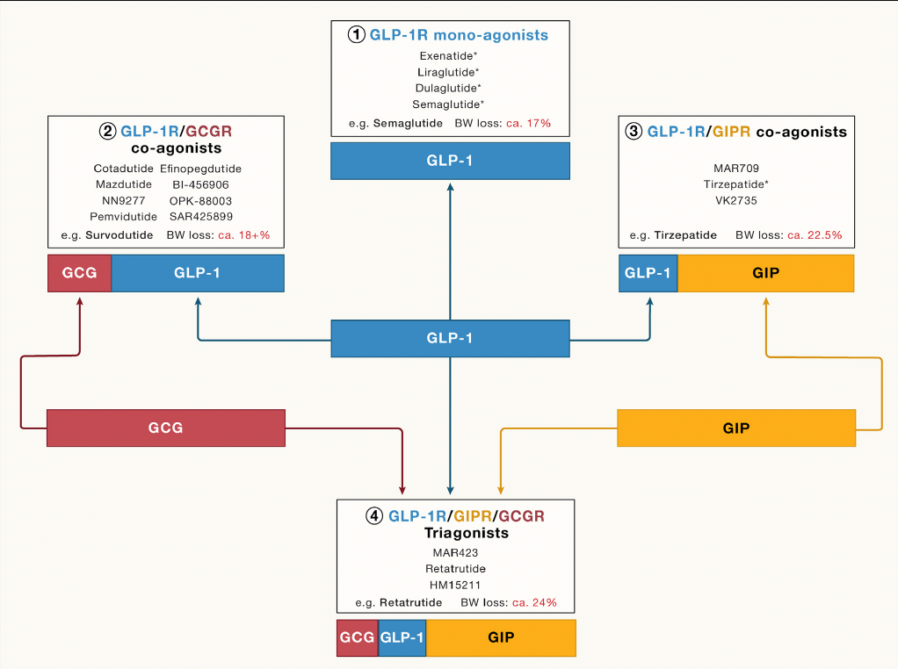

Slide 8
The effects of GLP-1RA on CV risk factors
Improves glucose metabolism³
Reduces body weight^{2,3}
Reduces risk of MACE in patients with T2D at high CV risk^{4–6}
Reduces inflammation^{2,7}
Improves lipid profile and reduces blood pressure^{2,3}
Shown to have anti-atherosclerotic effects
CV, cardiovascular; GLP-1RA, GLP-1, glucagon-like peptide-1 receptor agonist; HFpEF, heart failure with preserved ejection fraction; MACE, major adverse cardiovascular events; T2D, type 2 diabetes.
1. Arnett DK, et al. Circulation. 2019;140:e596–e646; 2. Wilding JPH, et al. N Engl J Med. 2021;384:989; 3. Aroda VR, et al. Diabetes Metab. 2019;45:409–418; 4. Marso SP, et al. N Engl J Med. 2016;375:1834–1844; 5. Husain M, et al. N Engl J Med. 2019;381:841–851; 6. Husain M, et al. Diabetes Obes Metab. 2020;22(3):442-451; 7. Knudsen LB, Lau J. Front Endocrinol (Lausanne). 2019;10:155; 8. Rakipovski G, et al. JACC Basic Transl Sci. 2018;3:844–857;.

Slide 9

Mechanisms for Cardiorenal Protection With SGLT2i
Recent results in nondiabetic experimental chronic kidney disease models
Sodium-glucose cotransporter 2 (SGLT2) inhibitors
↓ Oxidative stress
↓ Fibrosis induction
↓ Local inflammation
↓ Tubular senescence
↓ Glomerular damage
Natriuresis
Glucosuria
Tubulo-glomerular feedback
Glycemic control
Weight loss
Blood pressure lowering
Amelioration of volume overload
Intraglomerular pressure reduction
Possible direct renal protection
Renal protection
Cardiovascular protection
Zelniker. J Am Coll Cardiol. 2020;75:422.

Slide 10
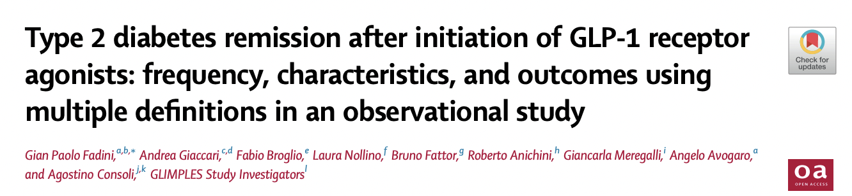
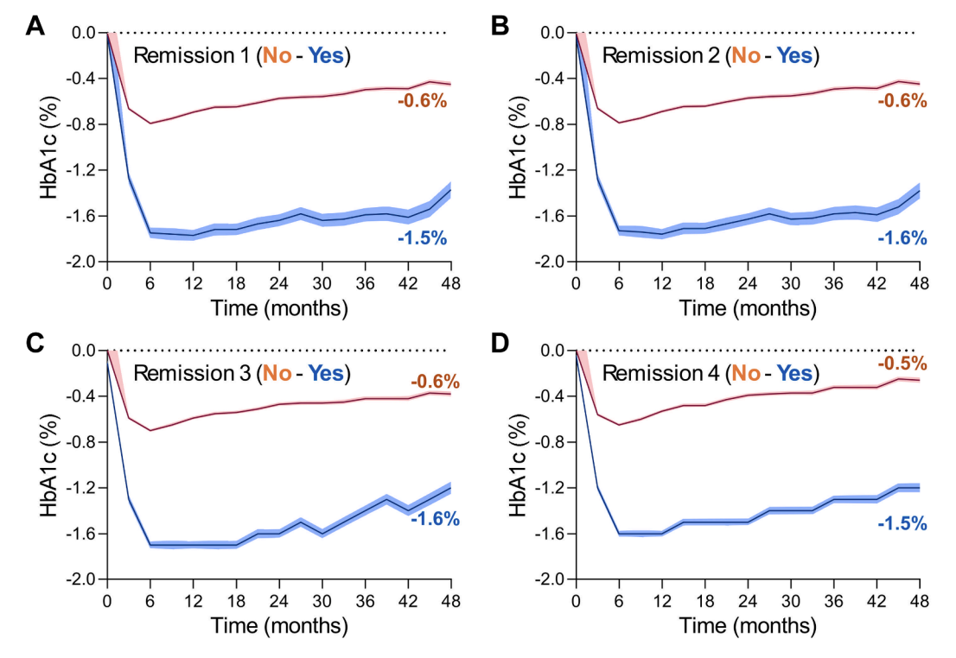
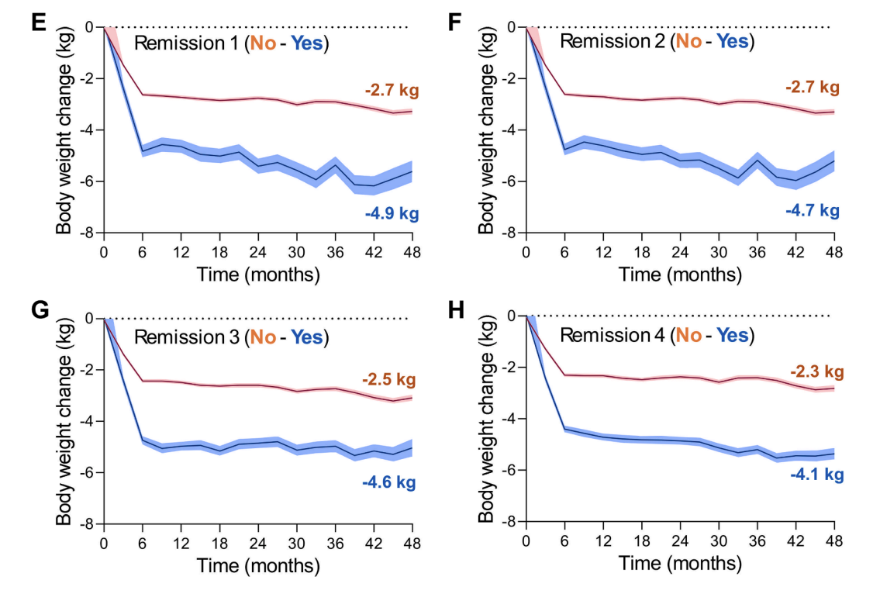

Slide 11
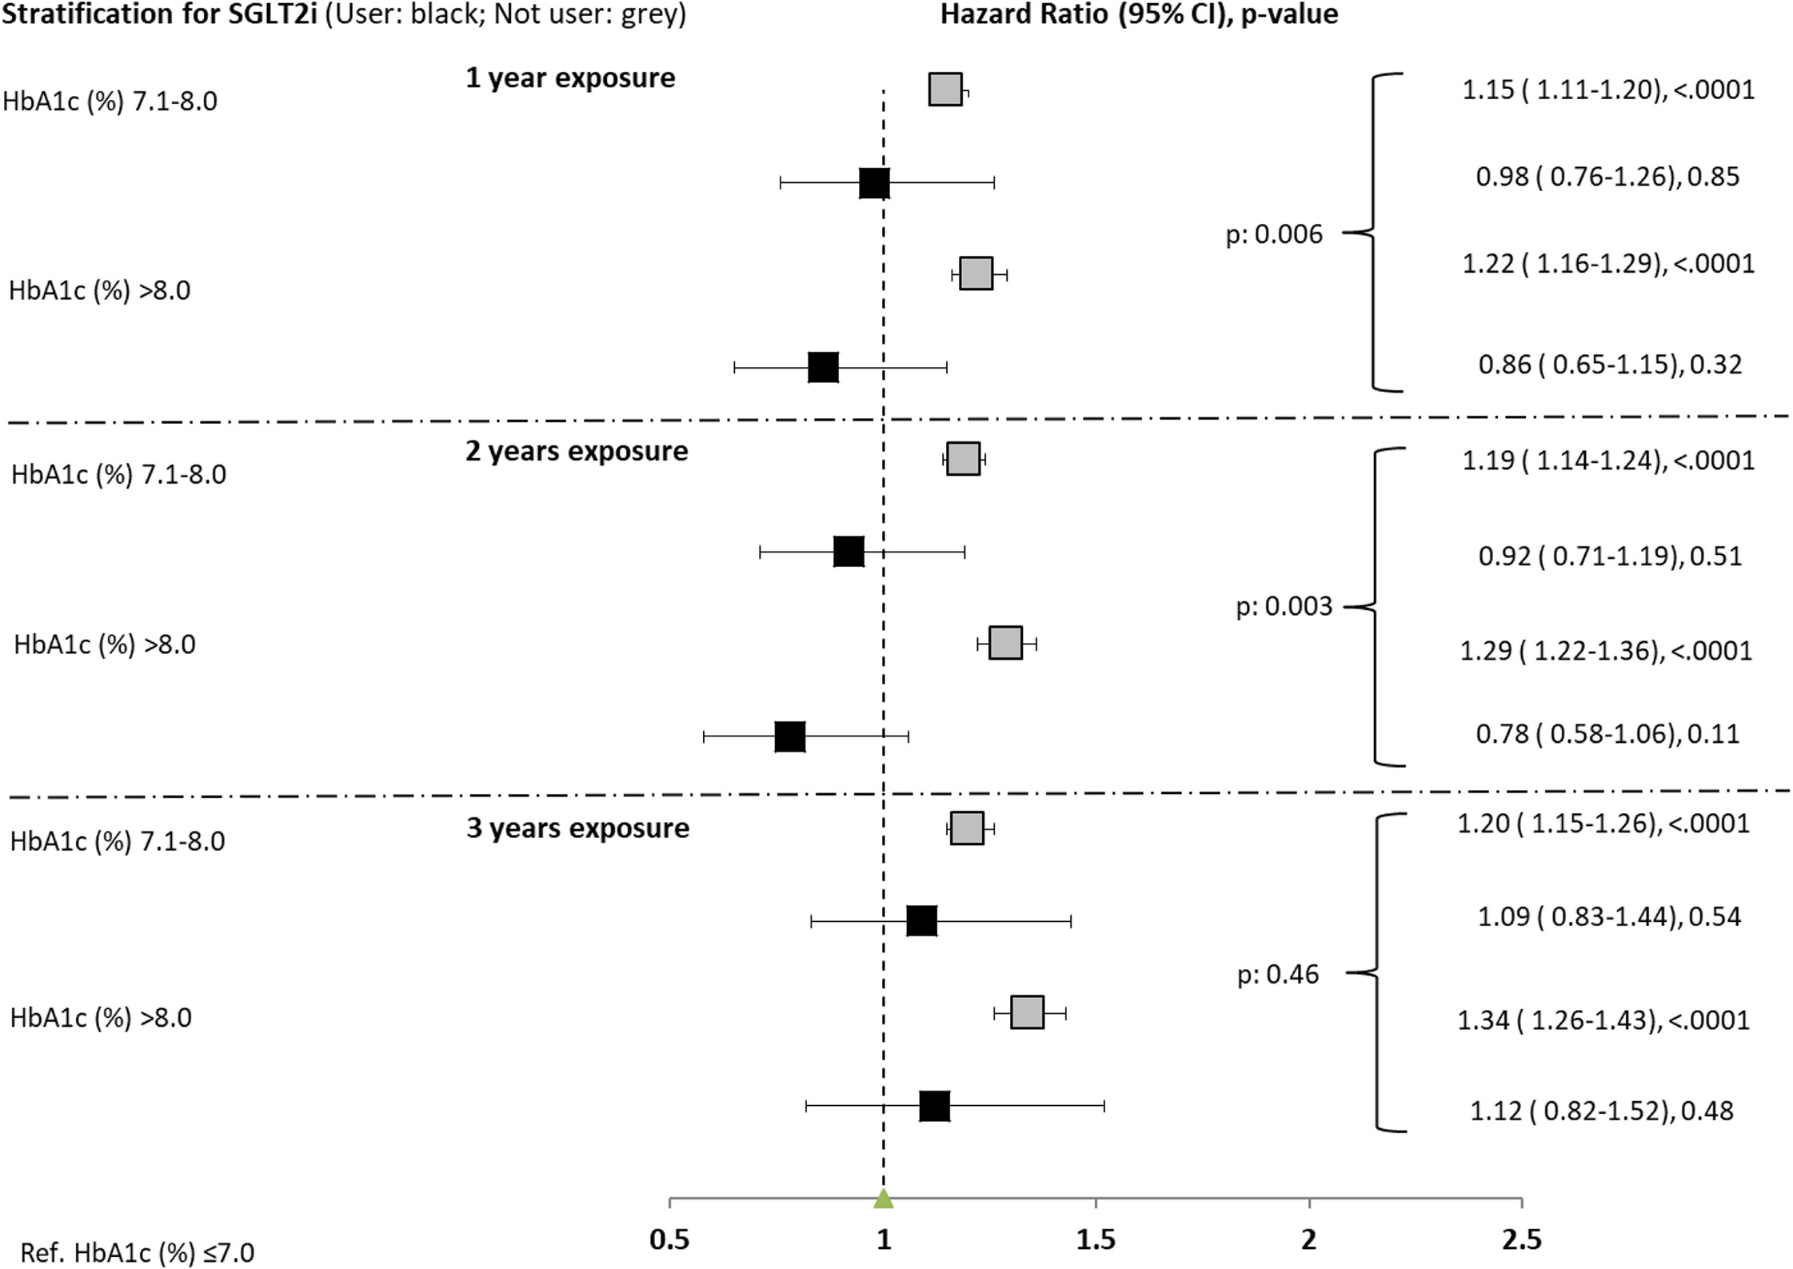
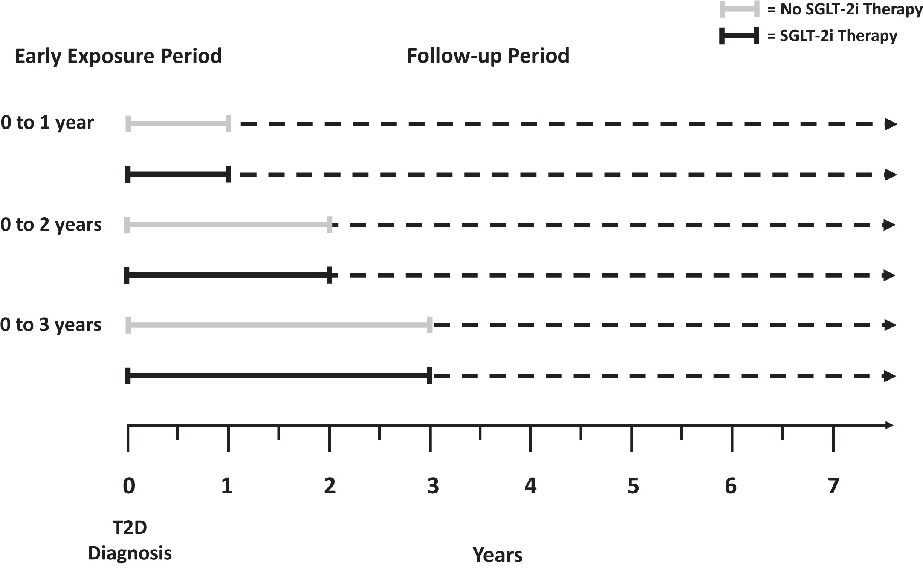
Early introduction of SGLT-2i attenuates metabolic memory
SGLT-2 inhibitors are mostly effective against cardiovascular risks if used within two years of T2DM diagnosis
Without SGLT2-i
SGLT2-i
Ceriello A, Lucisano G, Prattichizzo F, et al. The legacy effect of hyperglycemia and early use of SGLT-2 inhibitors: a cohort study with newly-diagnosed people with type 2 diabetes. Lancet Reg Health Eur. 2023 Jun 12;31:100666.
Notes:
Early introduction of SGLT-2i attenuate metabolic memory. Pseudo-forest plot showing the adjusted hazard ratios (HR) with the relative 95% confidence interval (CI) and the p value, derived from the Cox regression analyses exploring the associations between glycemic control and the risk of the CVD at follow-up in patients stratified according to use of SGLT-2i during the exposure phase or not users, in the three exposure periods assessed. HbA1c ≤ 7% is the reference.
Many patients at T2D diagnosis already have some form of organ damage

Slide 12
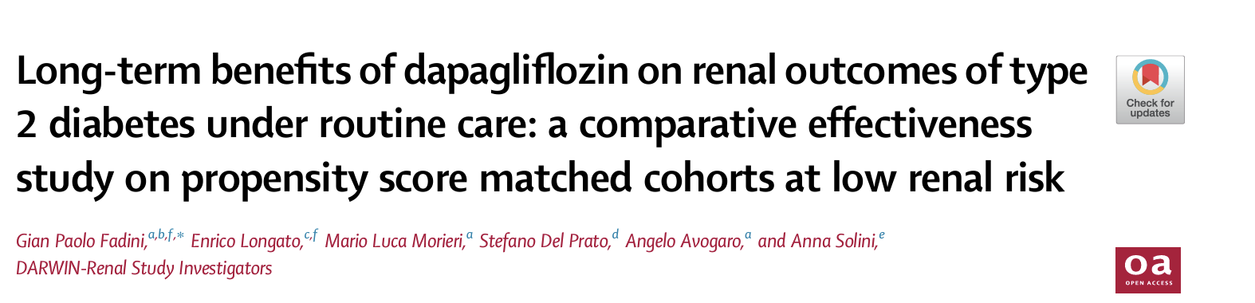
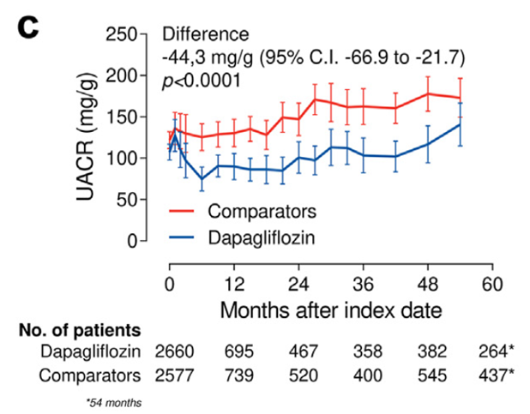
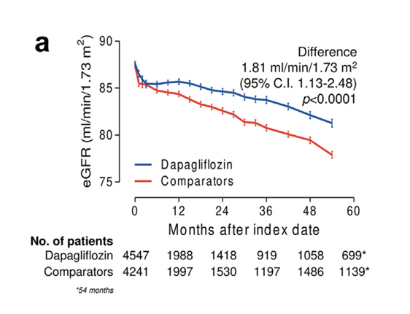
DARWIN-renal: Outstanding results on eGFR and Albuminuria

Slide 13
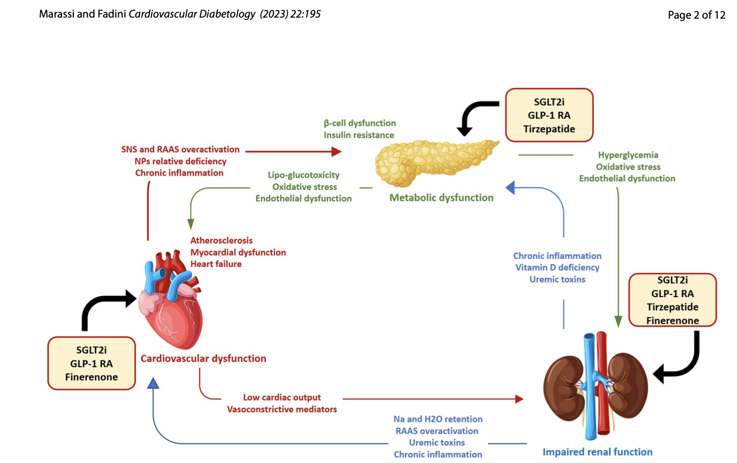
Diabetologist

Slide 14
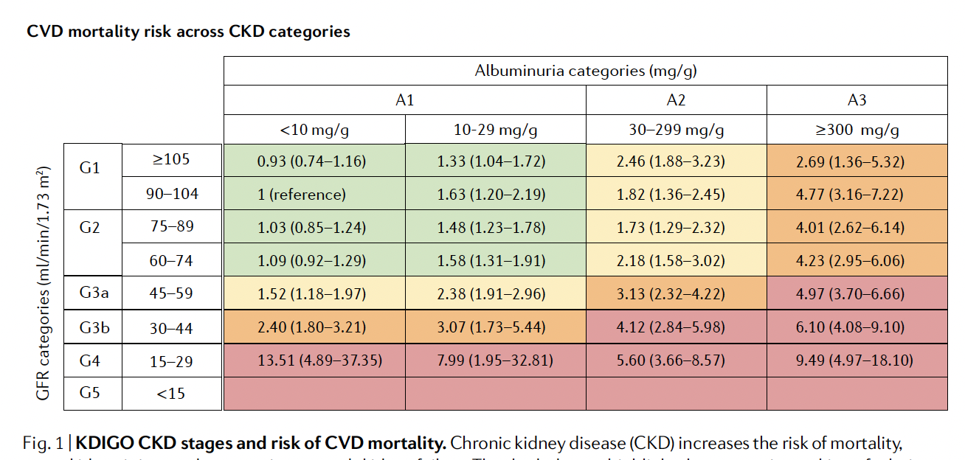
CVD mortality risk across CKD categories
Matsushita K., et al. Epidemiology and risk of cardiovascular disease in populations with chronic kidney disease. Nat Rev Nephrol. 2022 Nov;18(11):696-707. doi: 10.1038/s41581-022-00616-6.

Slide 15
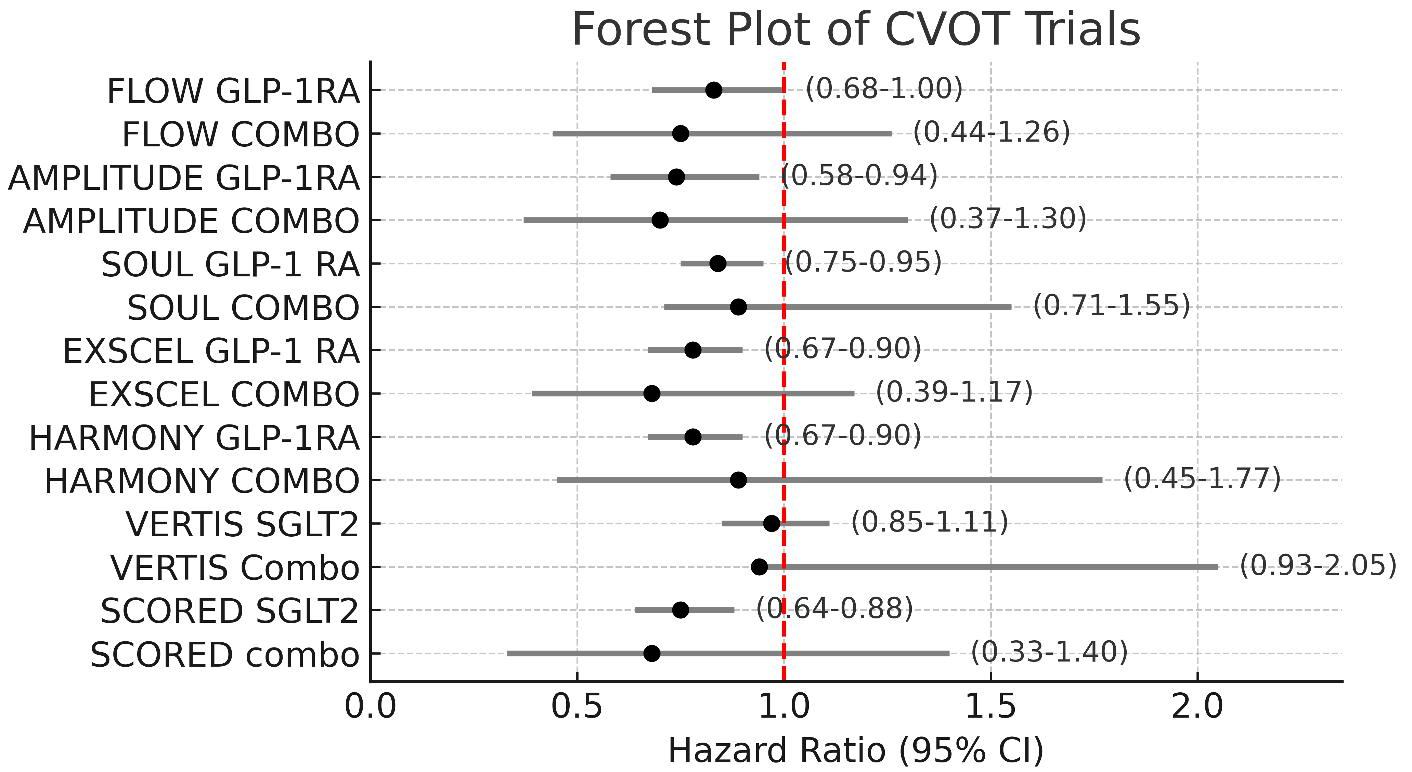
Effect on MACE
Avogaro et al. Acta Diabetologica, in Press

Slide 16
Effect on MACE
Avogaro et al. Acta Diabetologica, in Press

Slide 17
Spared events per 1000 prs/5 yrs with SGLT2i and GLP-1RA vs. Placebo
Palmer SC et al., BMJ . 2021 Jan 13;372:m4573

Slide 18
Time to kidney replacement therapy
85
Placebo
Empagliflozin
eGFR (ml/min/1.73 m²)
3.5
5.4
20.8
47.5
Difference: 1.9 years
Difference: 26.6 years
Time to kidney replacement therapy (years)
Notes:
===DO NOT REMOVE the next lines===
KeyMessage: EMP-CKD-EFF-002
SlideTitle: time to kidney replacement therapy
GlobalID: SC-CRP-12467
CriticalSuccessFactor: EMP-2023-CSF3
CommunicationTheme: Efficacy
L1Message: eGFR slope
=============================================

Slide 19
Grazie

